Slide 1

FPT EDUCATION
Arduino - ESP8266/ESP32 - Raspberry Pi
Comparison – Applications – Choosing the Right One
04/08/2025
Version 3.1

Slide 2
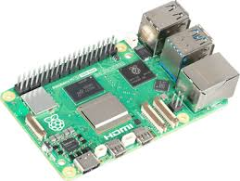
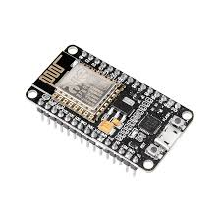
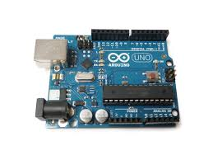
General Introduction
Arduino: simple, open-source microcontroller board)
ESP: microcontroller with integrated Wi-Fi/Bluetooth (ESP32 & ESP8266)
Raspberry Pi: single-board computer running Linux, highly versatile

Slide 3
History
Arduino originated in Italy in 2005 for education and makers
Arduino: few KB SRAM + internal Flash
ESP8266 released in 2014, ESP32 in 2016 with added Bluetooth/Wi-Fi
ESP32: ~520 KiB SRAM, external Flash, internal ROM
Raspberry Pi launched in 2012, designed to teach programming
Raspberry Pi: RAM up to 16 GB, microSD / NVMe or USB storage

Slide 4
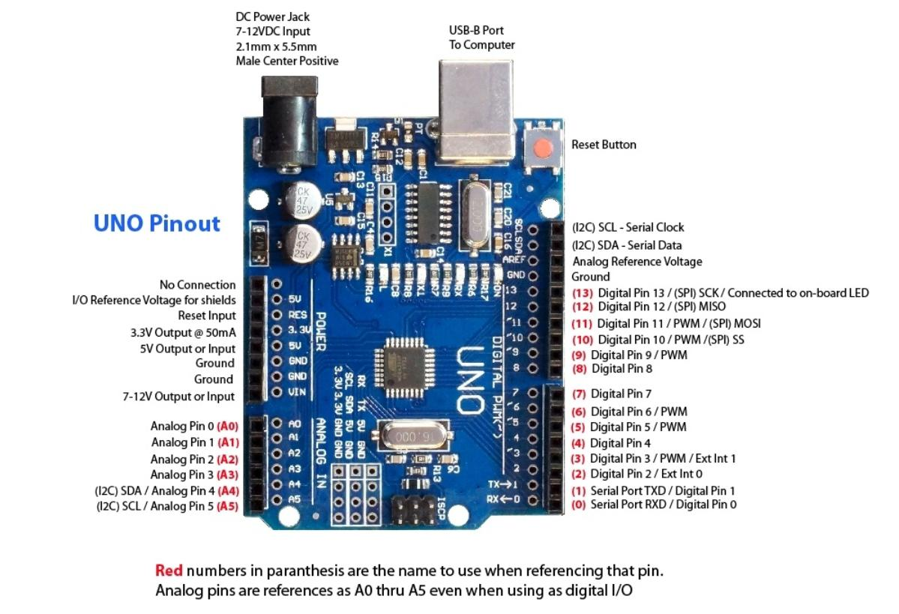
Arduino Hardware

Slide 5
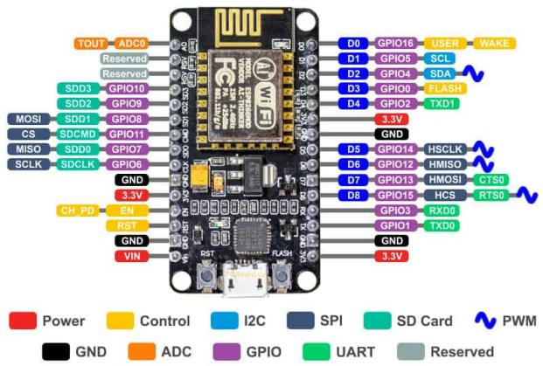
NodeMCU ESP Hardware

Slide 6
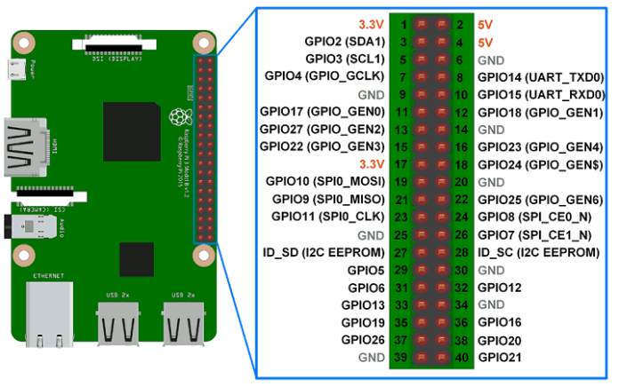
Raspberry Pi Hardware

Slide 7
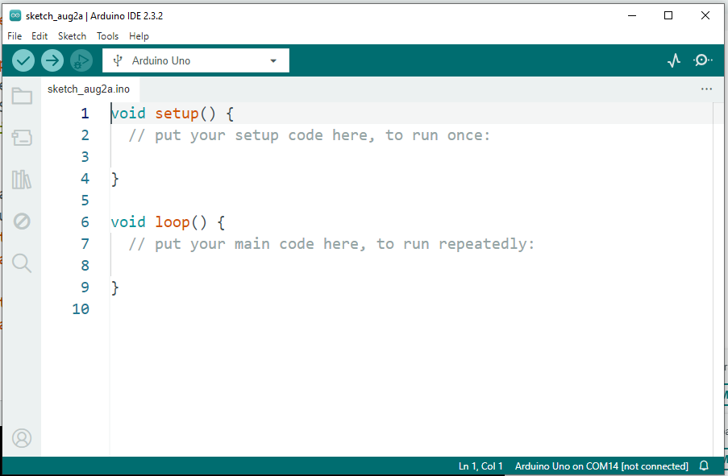
Arduino IDE

Slide 8
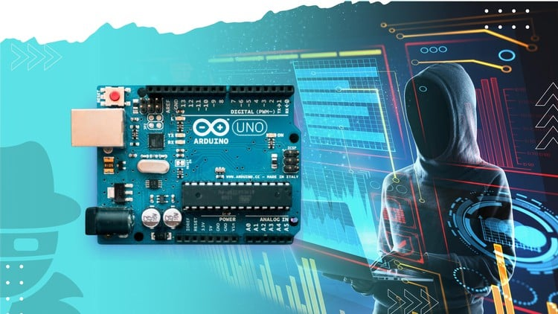
Real-World Applications: Arduino

Slide 9
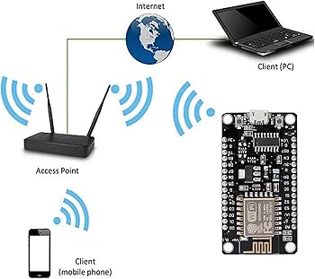
Applications of ESP

Slide 10
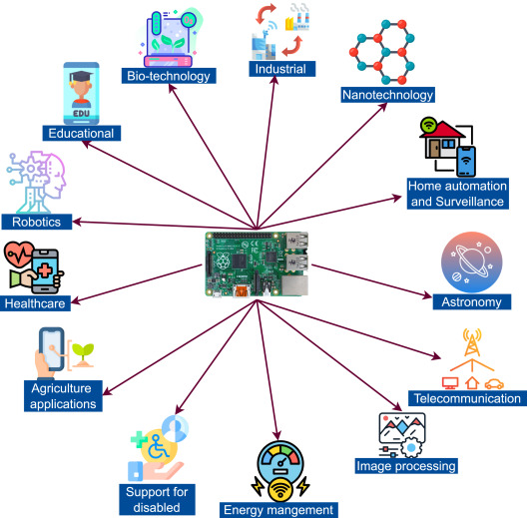
Applications of Raspberry Pi

Slide 11
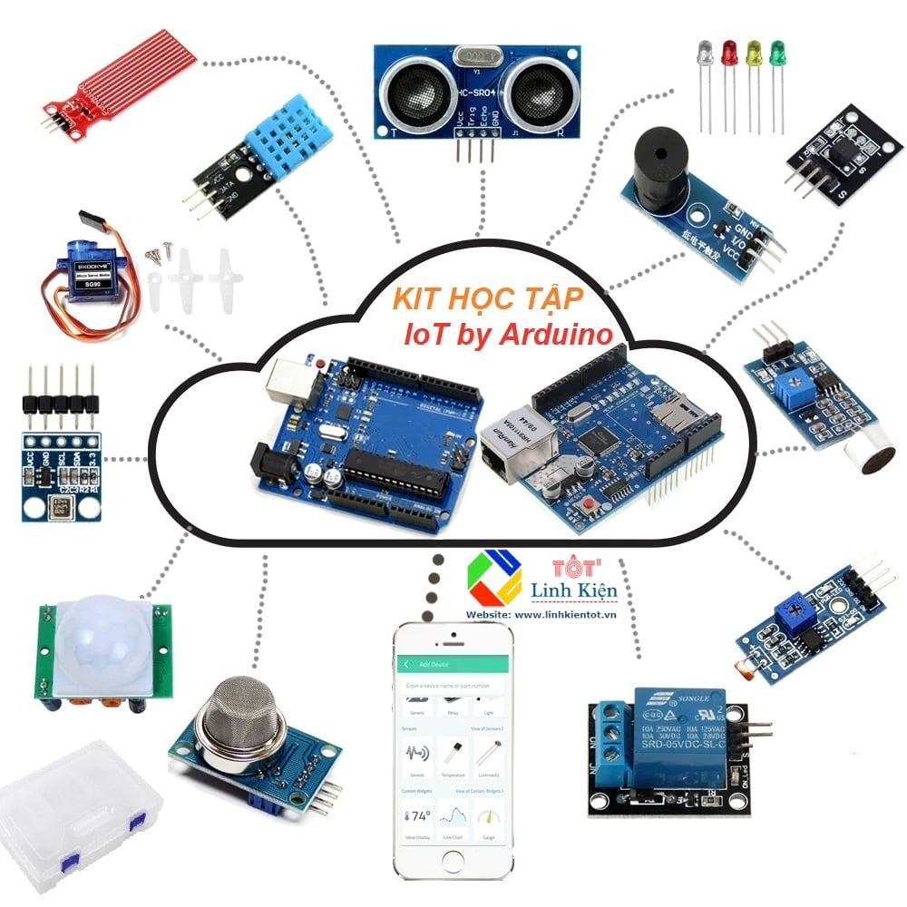
IOT by Arduino KIT

Slide 12
Reference
[1]. https://www.arduino.cc
[2]. https://www.youtube.com/watch?v=DyP7XUnsq7k
[3]. https://raspberrypi.vn/
[4]. https://www.tinkercad.com/
[5]. https://app.cirkitdesigner.com/
[6]. https://www.circuito.io/

Slide 13
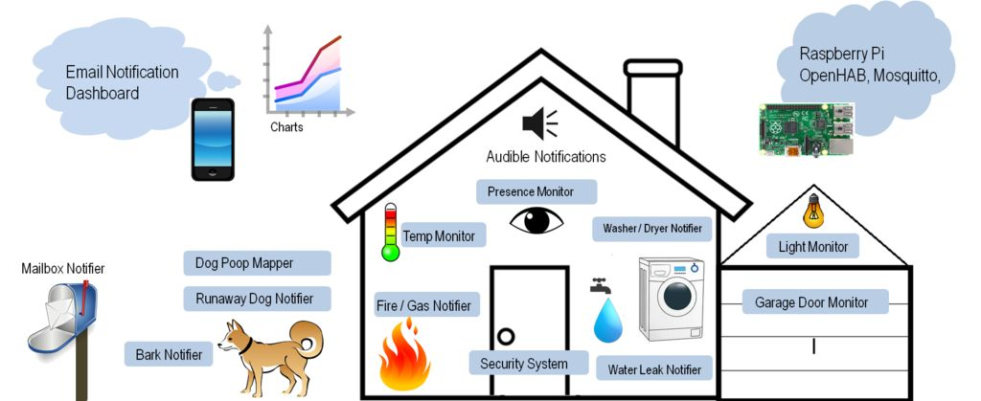
Thank you

